Slide 1
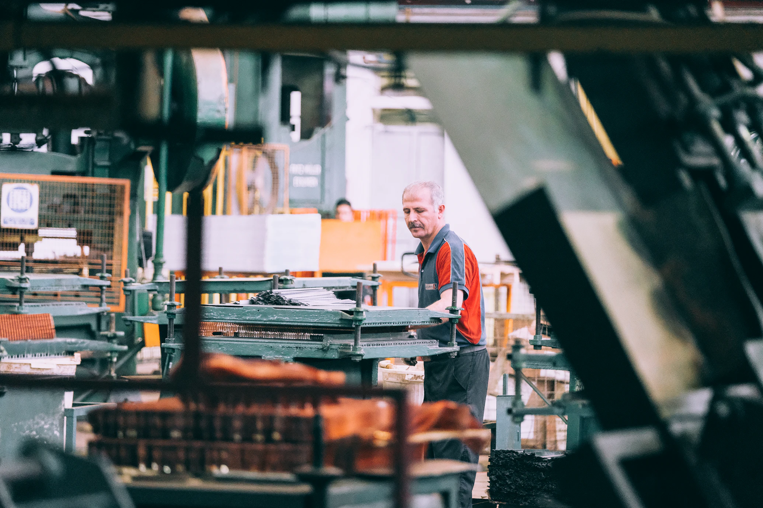
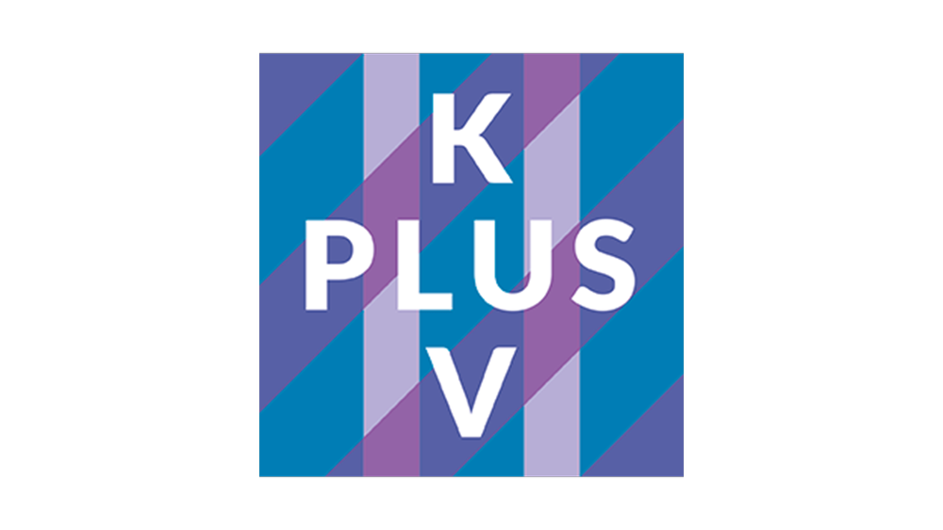
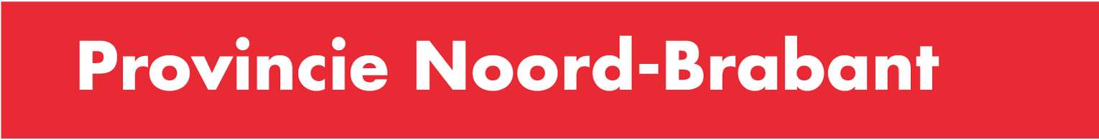

CVC FAST
FORWARD
Remanufacturing the future
CVC FF 2025-2028

Slide 2






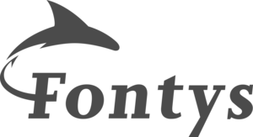





MISSION OF CVC FAST FORWARD
Supports entrepreneurs in the manufacturing industry that aim to practically accelerate circular business growth.
The province of Noord-Brabant strives towards a circular transition in its economy. The circular economy will contribute to a 50% reduction of resource utilization by 2030.
Toward a circular manufacturing
industry through
chain collaboration
THE CVC COMMUNITY
Follow this mission, the CVC community supports organizations in the regional manufacturing industry towards circularity.
The CVC Fast Forward 2025-2028 is facilitated by KplusV and ImpactX
Notes:
The CVC community consists of parties such as Metaalunie, FME, the four regional development organizations of Brabant, the technical university of Eindhoven and the Fontys university of applied sciences. Together, they support organizations in the local manufacturing industry towards circularity.

Slide 3
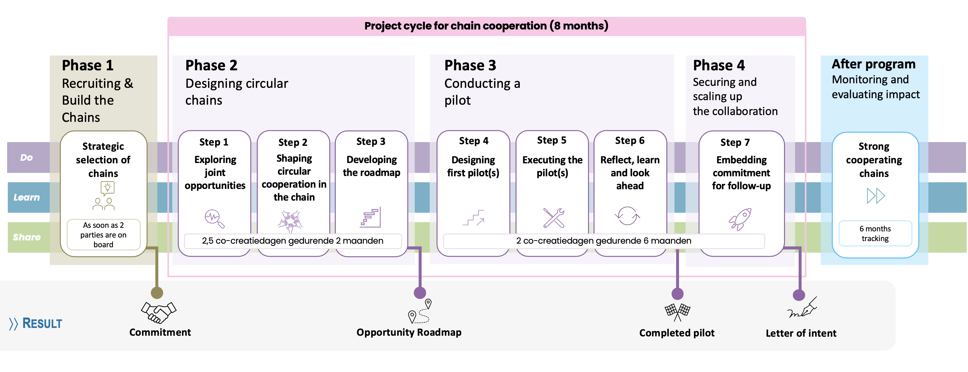
CHAIN COLLABORATION JOURNEY
A guided and structure process - creating joint roadmaps, implementing pilots, and establishing long-term partnerships.
Flexible start: chains can begin as soon as you are ready (min. 2 parties commit to participate in the chain project).
No financial contribution required from participating companies, only in-kind contributions (2 participants per party).
Each phase is built around a co-creation session in which all participating companies align their goals and focuses.

Slide 4
CHAIN COLLABORATION JOURNEY
Interested companies are expected to partner with at least one other party from their chain to participate in the chain project.
The chain project team will be supported in the identification of opportunities for their future circular production chain, development of suiting circular business models and essential breakthroughs, and working on concrete pilot results.
Each phase is built around a co-creation session in which all participating companies align their goals and focuses.
The costs for guidance in the program are covered by the province of Noord-Brabant, the participating companies do not have to pay their own financial contribution but dedicated in-kind contribution.
The regional ecosystem is actively involved throughout the journey to support their chain project in creating impact that contribute to the objectives of the region .

Slide 5
Accelerating together, outside of usual frameworks

Slide 6

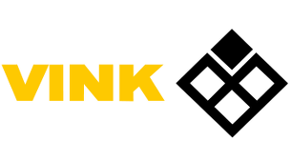

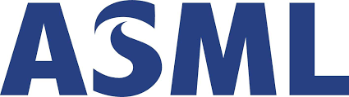

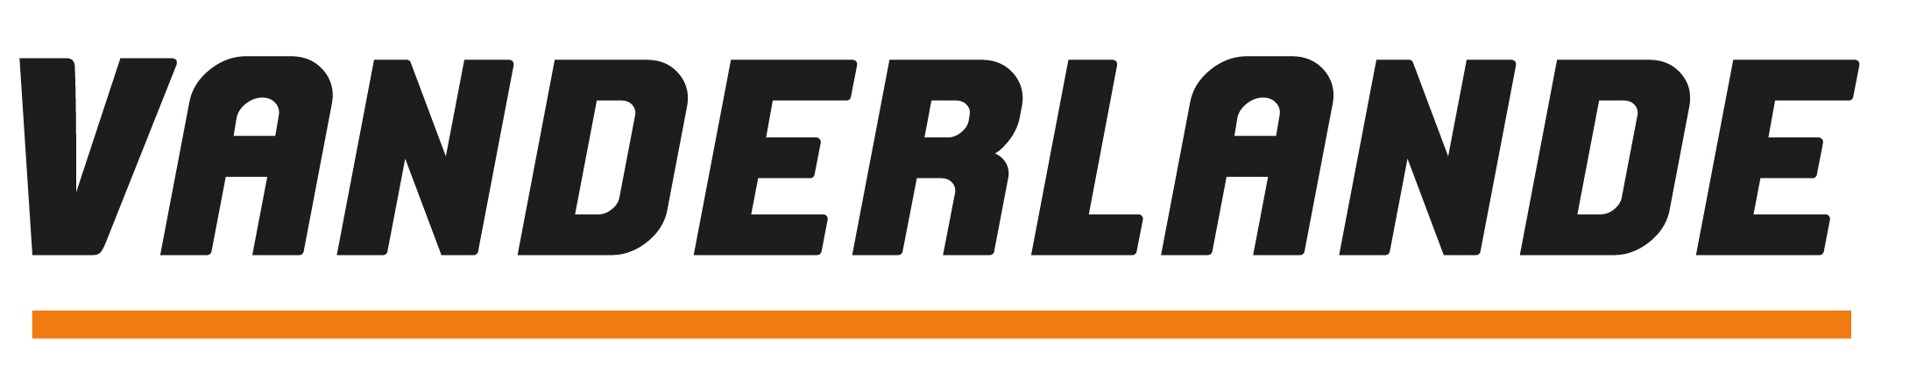


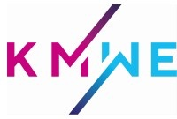
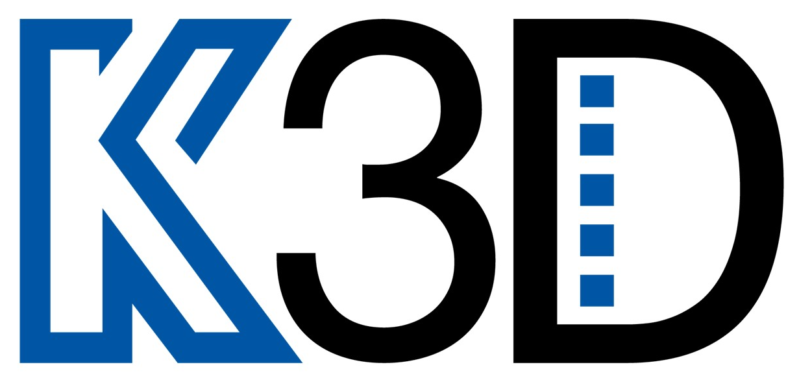

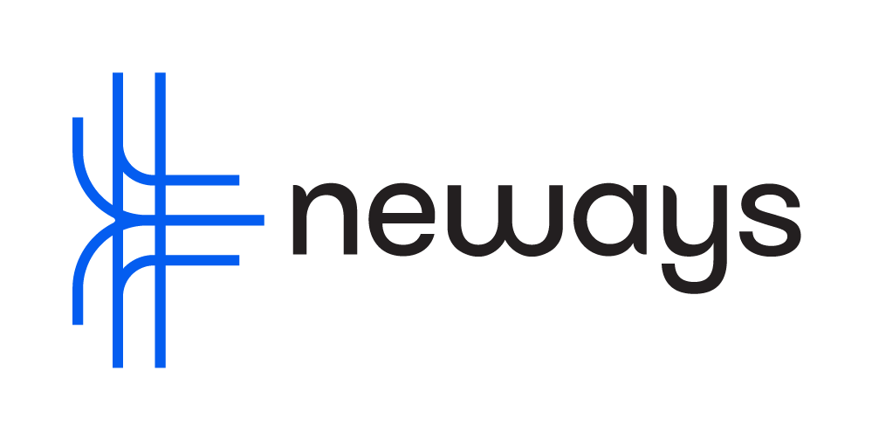


Chain 1
PARTICIPATING COMPANIES OF PREVIOUS CVC FAST FORWARD (2023-2025)
Circular plastics in cleanrooms
Chain 2
Participants scored the CVC Fast Forward program a 4,3 out of 5!
Circular model for a parcel sortation system
Chain 3
Turn residual metal to feedstock for AM industry
*English is chosen as the default language for CVC FF to inclusively support the supply chain partners that may not originally Dutch companies.
Chain 4
Setup circular electronic chain for electron microscop

Slide 7


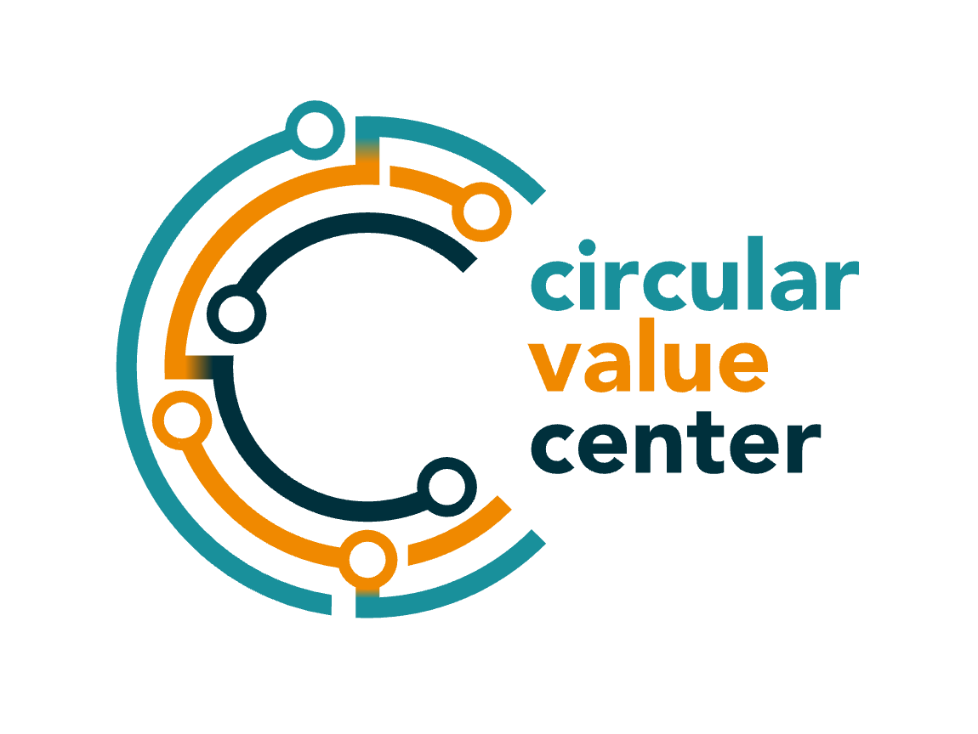
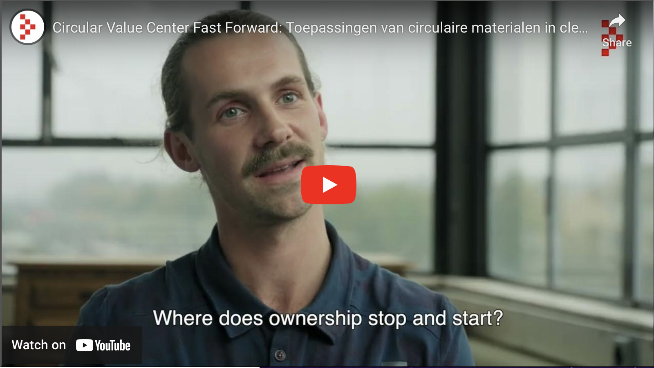

Design requirements with available products and R&D capabilities in the supply chain
An agreement on quality control
An approved testing process for new recycled materials
A HIGH-PERFORMANCE CIRCULAR PLASTIC MODEL FOR CLEANROOM PACKAGING
HQ Pack, Vink, ASML, and Mitsubishi Chemical Group as one project team successfully tested circular materials (recycled POM-C) to be applied in cleanroom packaging. The solution will significantly reduce the carbon footprint of the materials involved (estimated reduction = 78% CO2 emission vs virgin materials).
Click to watch the movie
This case was created and is owned by ImpactX, the facilitator of the previous CVC FF.

Slide 8
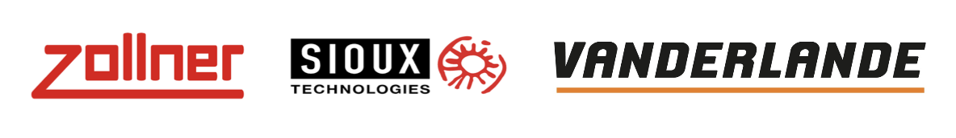
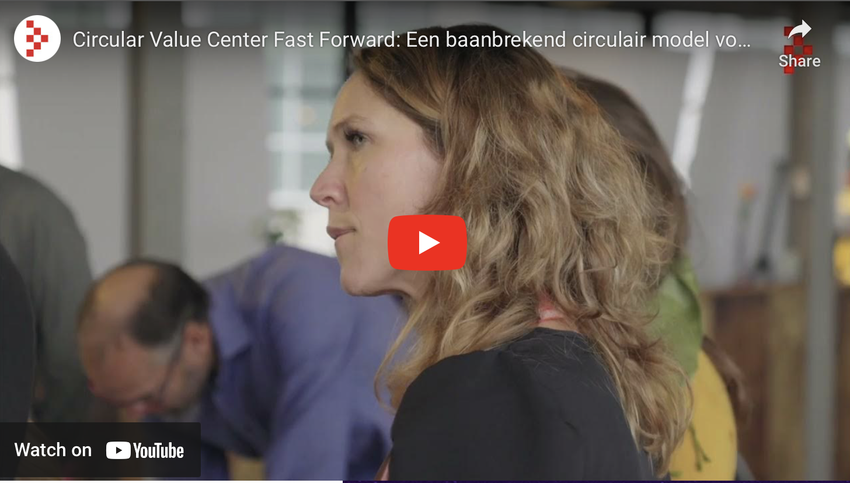
BLUEPRINTING A GAME-CHANGING CIRCULAR MODEL FOR A PARCEL SORTATION SYSTEM
Insights from an end user such as DHL (representing the voice of the customer)
Rethink the remanufacturing process to be integrated into normal production
Learnings applicable to other projects
Vanderlande, one of its key customers, and suppliers Zollner and Sioux collaborated on implementing Cradle-to-Cradle principles for a new sortation solution. By exploring several circular design paths (Repair, Remanufacture, Recycle), all parties could see what was required to make change a reality. The final blueprint is believed to have potential of reusing 80% of materials & a significant reduction in carbon footprint (~50%).
Click to watch the movie
This case was created and is owned by ImpactX, the facilitator of the previous CVC FF.

Slide 9
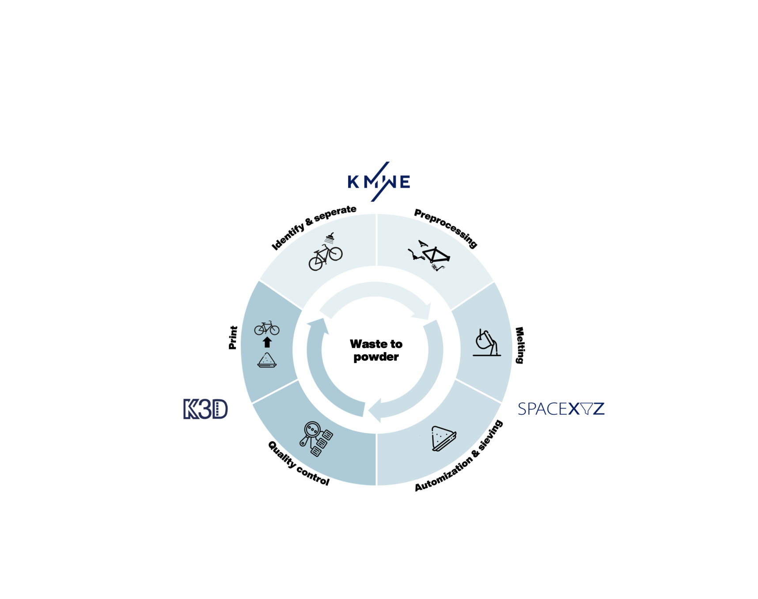
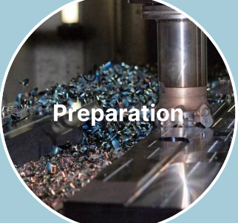
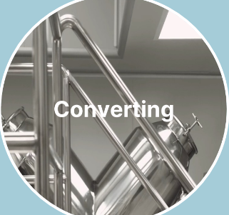
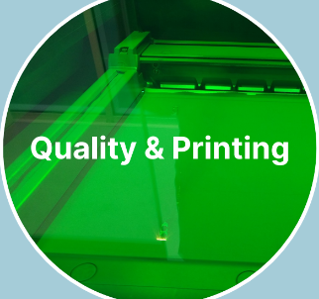
Formed a future-ready circular consortium with a signed Letter of Intent(LOI) to scale the initiative
Concept ready and execution plan set - focusing on creating a unique new value proposition
Defined a 3-year roadmap and successfully submitted the grant application
FROM (RESIDUAL) METAL TO RAW MATERIAL FOR ADDITIVE MANUFACTURING
High-value alloys used in AM are expensive, scarce, and reliant on centralized recycling and global supply chains. Current metal waste is underutilized or discarded.
By jointly clarifying dependencies & responsibilities, and defining the direction of this powder value chain, the initiative has moved from concept to a ready-to-launch prototype.
Together, the chain has co-created the impact on:
Lower material costs and CO₂ footprint, supporting sustainable manufacturing
Strengthens supply chain resilience through localized feedstock
Cuts waste & efficiently recovers (critical) metals by 90%
This case was created and is owned by ImpactX, the facilitator of the previous CVC FF.

